Slide 1
CSE 204 - INTRO TO Database Systems Database Analysis
Joseph LEDET
Department of Computer Engineering
Akdeniz University
josephledet@akdeniz.edu.tr

Slide 2
Quote of the day
The analysis of concepts is for the understanding nothing more than what the magnifying glass is for sight.
Moses Mendelssohn

Slide 3
Outline
When fact-finding techniques are used in the database application lifecycle.
The types of facts collected in each stage of the database application lifecycle.
The types of documentation produced in each stage of the database application lifecycle.
The most commonly used fact-finding techniques.
How to use each fact-finding technique and the advantages and disadvantages of each.
About a property rental company called DreamHome.
How to apply fact-finding techniques to the early stages of the database application lifecycle.

Slide 4
Fact-finding techniques
It is critical to capture the necessary facts to build the required database application.
These facts are captured using fact-finding techniques.
The formal process of using techniques such as interviews and questionnaires to collect facts about systems, requirements, and preferences.

Slide 5
When Are Fact-Finding Techniques Used?
Fact-finding used throughout the database application lifecycle. Crucial to the early stages including database planning, system definition, and requirements collection and analysis stages.
Enables developer to learn about the terminology, problems, opportunities, constraints, requirements, and priorities of the organization and the users of the system.

Slide 6
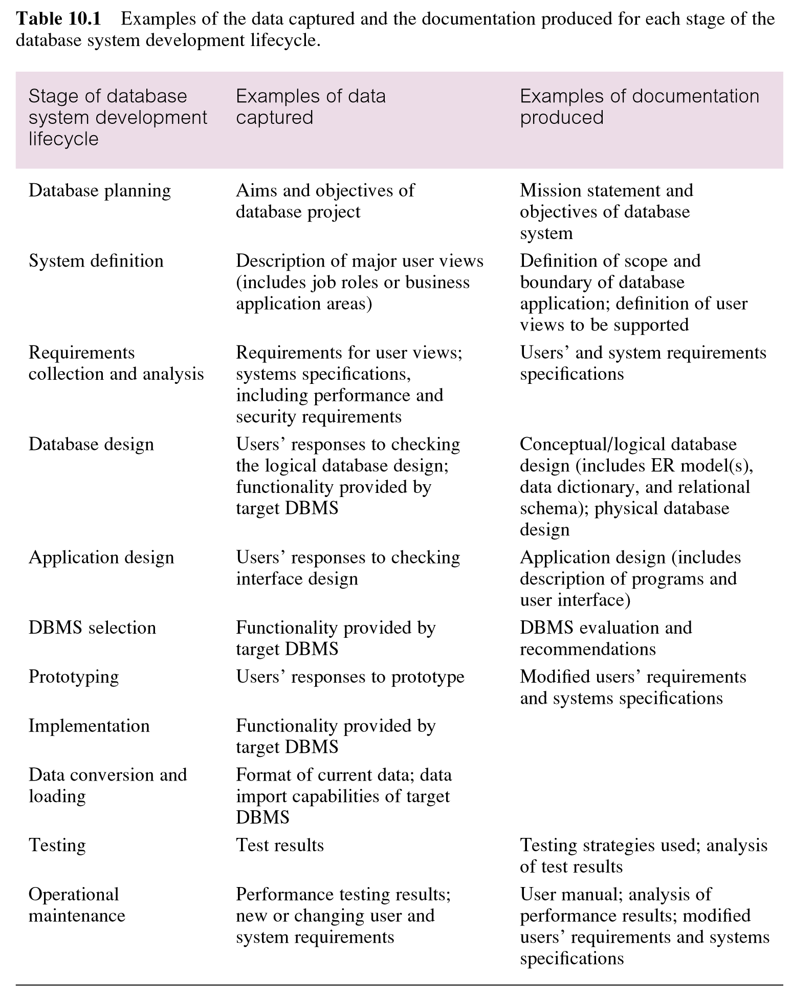
Examples of data captured and documentation produced during the database application lifecycle

Slide 7
Fact-Finding Techniques
A database developer normally uses several fact-finding techniques during a single database project including:
examining documentation
interviewing
observing the organization in operation
research
questionnaires

Slide 8
Examining documentation
Can be useful
to gain some insight as to how the need for a database arose.
to identify the part of the organization associated with the problem.
To understand the current system.

Slide 9
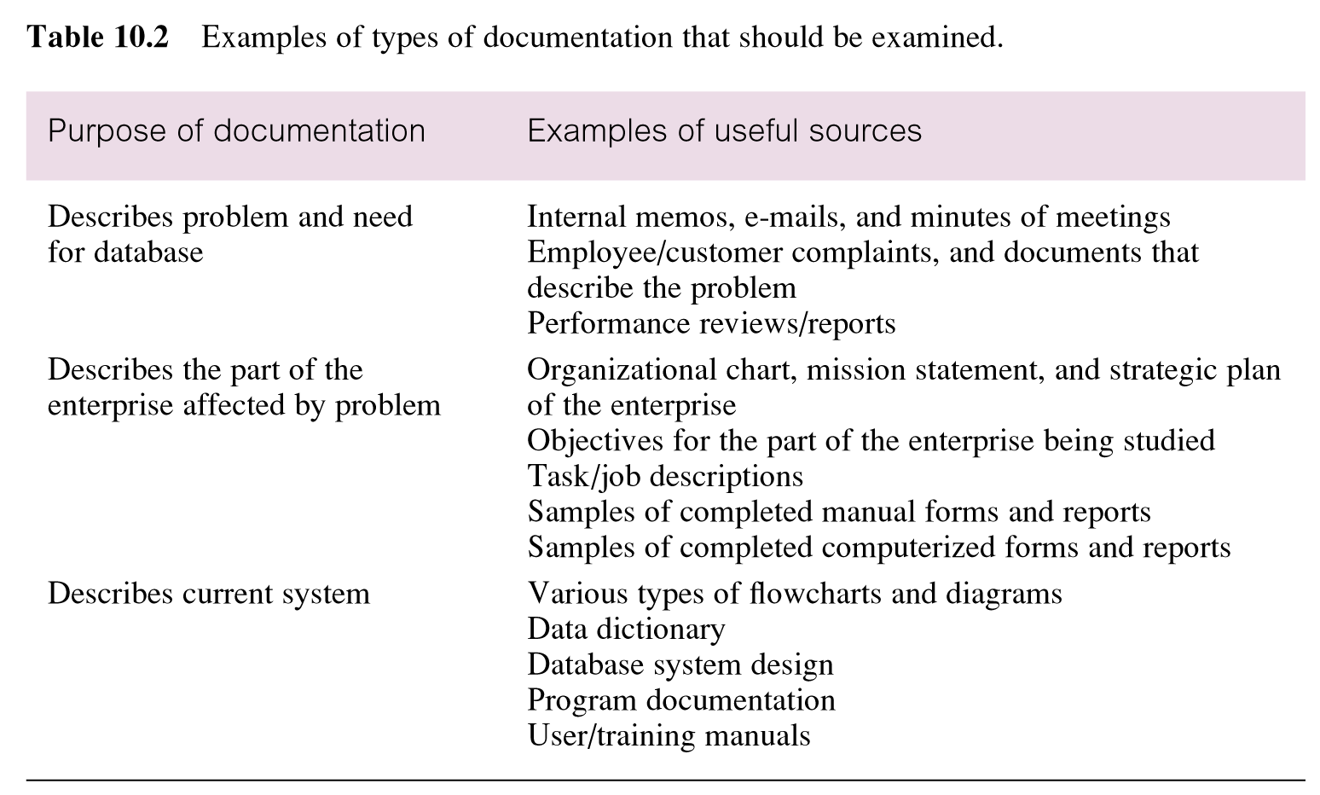
Examples of types of documentation that should be examined

Slide 10
Interviewing
Most commonly used, and normally most useful, fact-finding technique. Enables collection of information from individuals face-to-face.
Objectives include finding out facts, verifying facts, clarifying facts, generating enthusiasm, getting the end-user involved, identifying requirements, and gathering ideas and opinions.

Slide 11
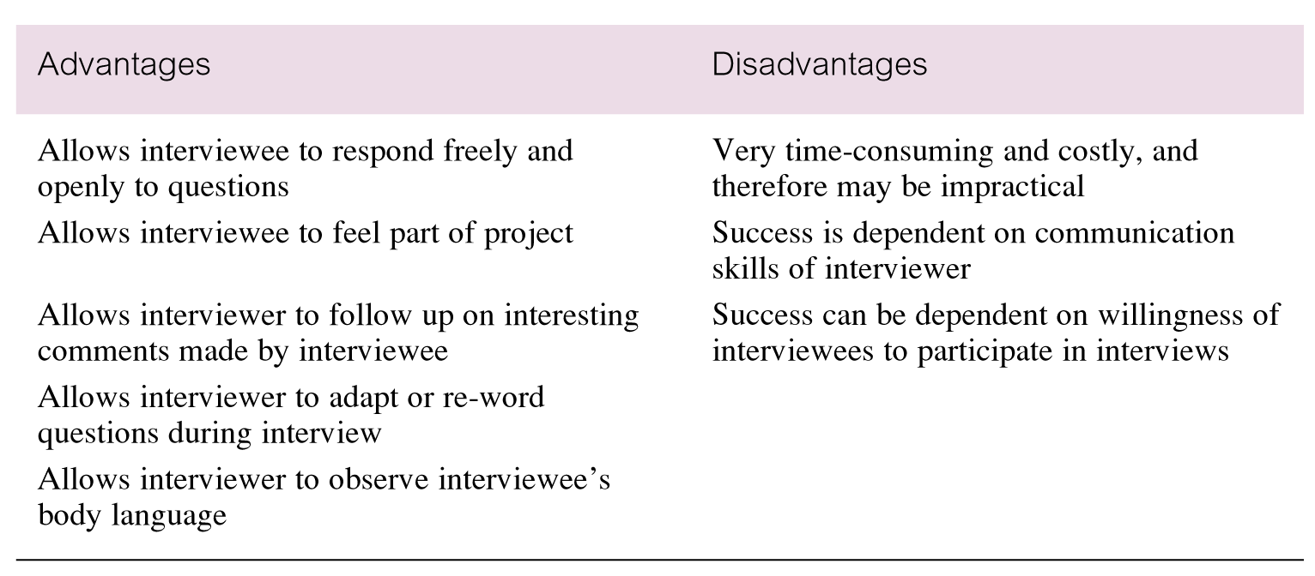
Advantages and disadvantages of interviewing

Slide 12
Interviewing
There are two types of interviews unstructured and structured.
Open-ended questions allow the interviewee to respond in any way that seems appropriate.
Closed-ended questions restrict answers to either specific choices or short, direct responses.

Slide 13
Observing the Organization in Operation
An effective technique for understanding a system.
Possible to either participate in, or watch, a person perform activities to learn about the system.
Useful when validity of data collected is in question or when the complexity of certain aspects of the system prevents a clear explanation by the end-users.

Slide 14
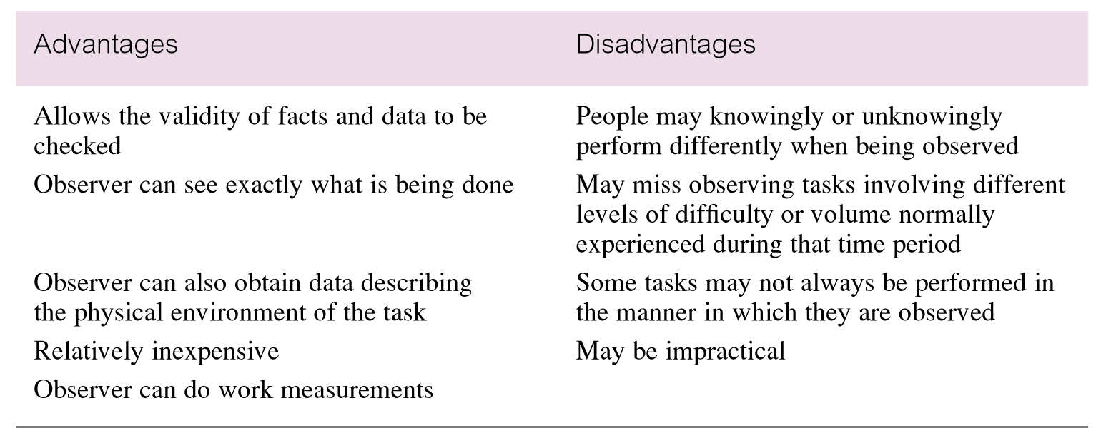
Advantages and disadvantages of using observation

Slide 15
Research
Useful to research the application and problem.
Use computer trade journals, reference books, and the Internet (including user groups and bulletin boards).
Provide information on how others have solved similar problems, plus whether or not software packages exist to solve or even partially solve the problem.

Slide 16
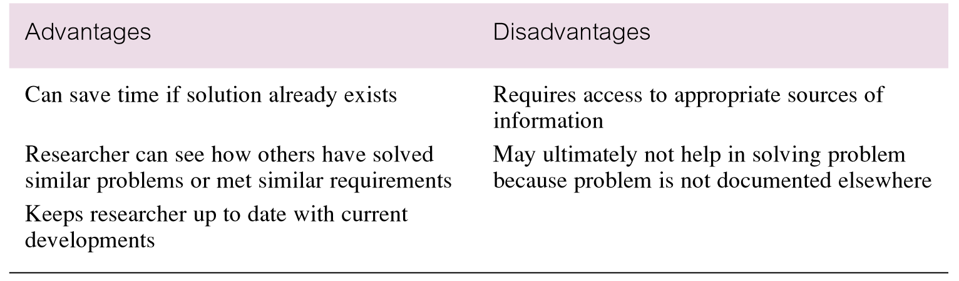
Advantages and disadvantages of using research

Slide 17
Questionnaires
Conduct surveys through questionnaires, which are special-purpose documents that allow facts to be gathered from a large number of people while maintaining some control over their responses.
There are two types of questions, namely free-format and fixed-format.

Slide 18
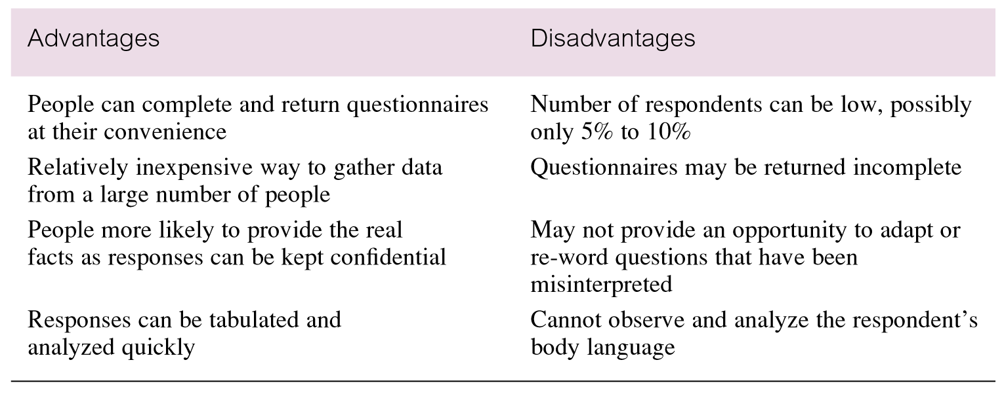
Advantages and disadvantages of using questionnaires

Slide 19
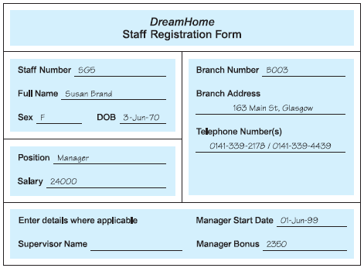
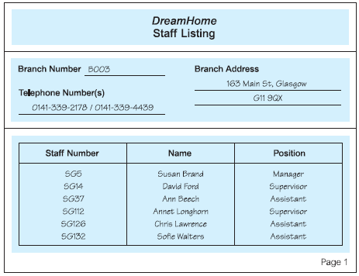
Using Fact-Finding Techniques – A Worked Example

Slide 20
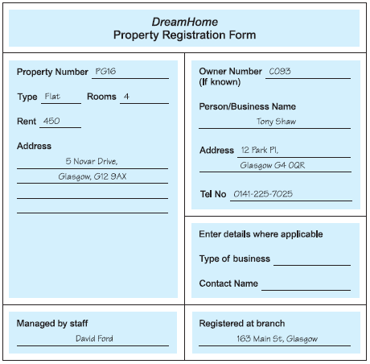
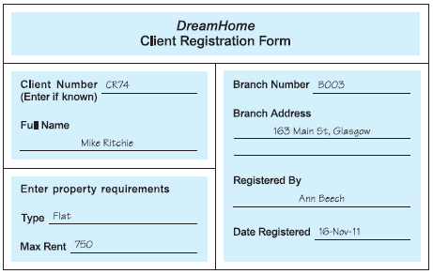
Using Fact-Finding Techniques – A Worked Example

Slide 21
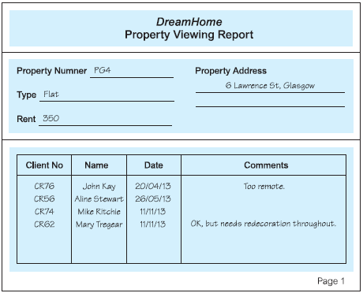
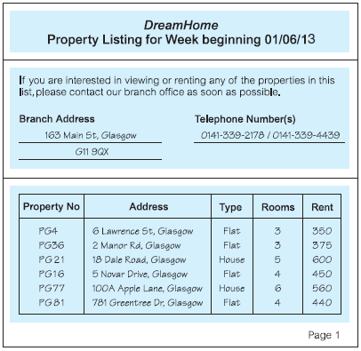
Using Fact-Finding Techniques – A Worked Example

Slide 22
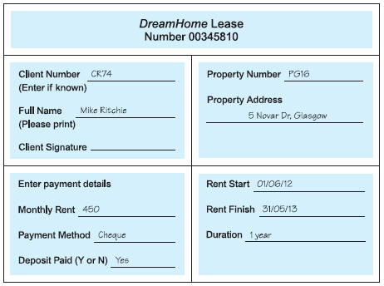
Using Fact-Finding Techniques – A Worked Example

Slide 23
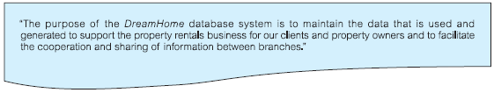
Mission Statement for DreamHome Database System

Slide 24
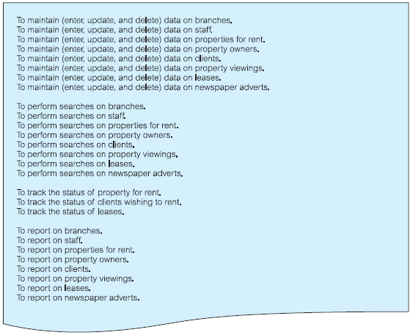
Mission Objectives for DreamHome Database System

Slide 25
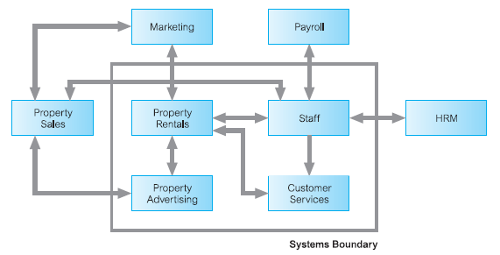
System Boundary for DreamHome Database System

Slide 26
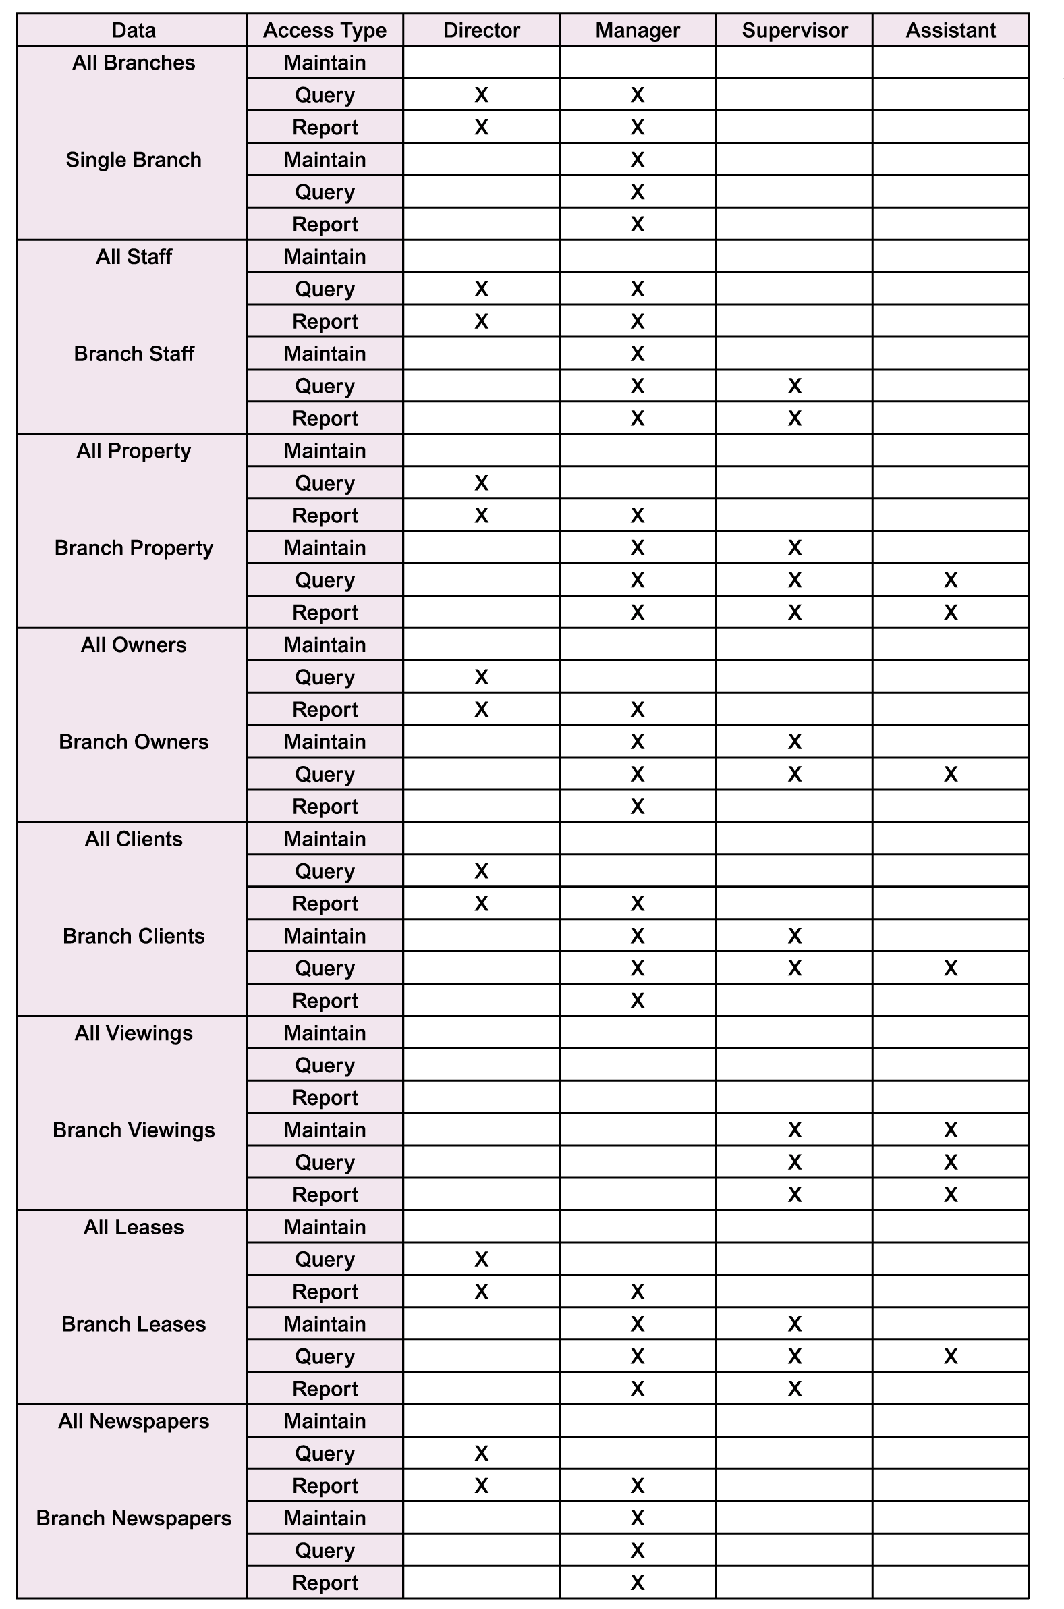
Major User Views for DreamHome Database System

Slide 27
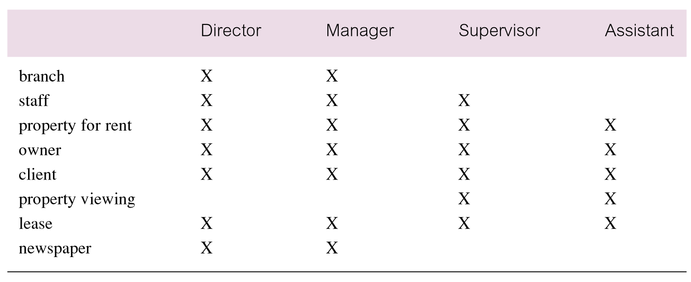
Cross-reference of user views with main types of data used by each

